Slide 1
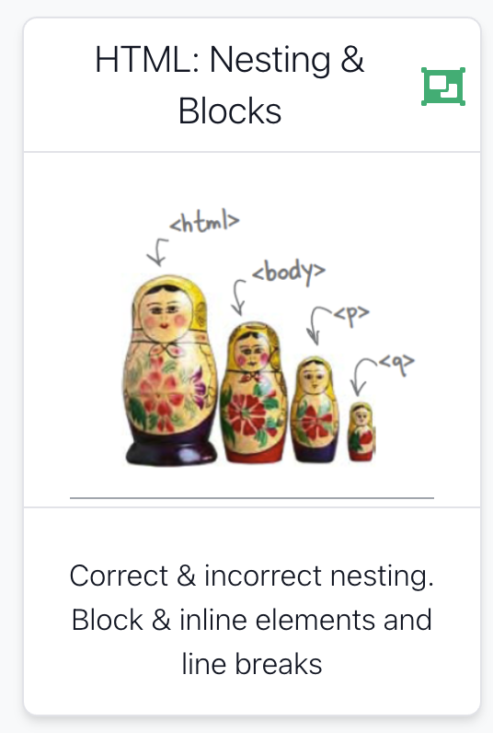

Slide 2

Some Key Concepts
Nesting of elements - specifically correct and incorrect nesting.
block and inline elements

Slide 3
Agenda
Nesting
Line break, Block & Inline Elements

Slide 4
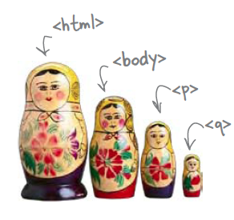
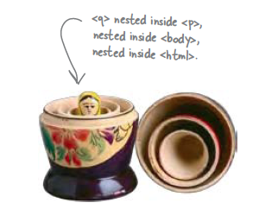
Nesting
When we put one element inside another element, we call that nesting.
We say, the <p>element is nested inside the <body>element.
We put a <body>element inside an <html>element, a <p>element inside a <body>element etc.

Slide 5
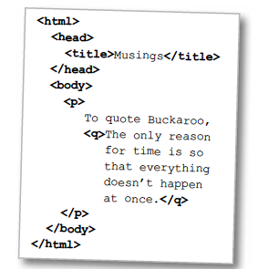
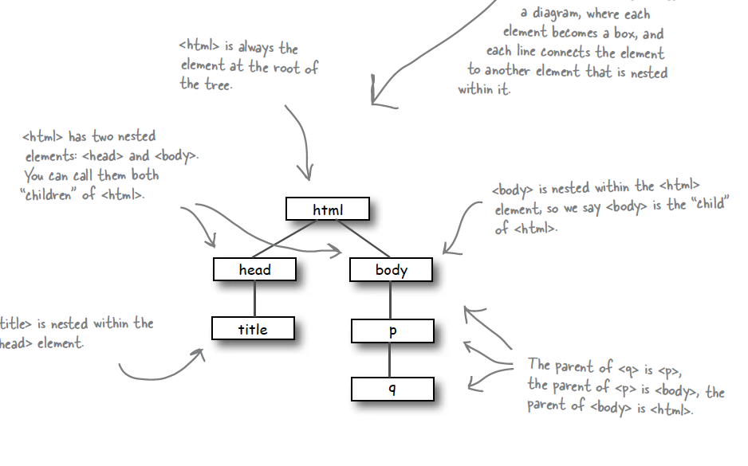
Nesting - Tree Structure
Text

Slide 6
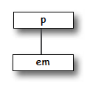
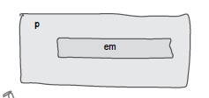
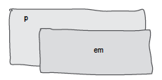
Nesting can be Incorrect!
<p>I’m so going to blog <em>this</em></p>
Good
<p>I’m so going to blog <em>this</p></em>
Bad
?

Slide 7
Agenda
Nesting
Line break, Block & Inline Elements

Slide 8
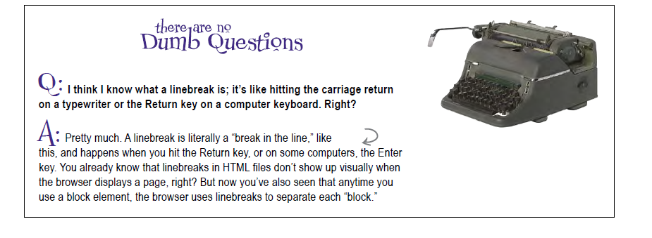
Line breaks

Slide 9
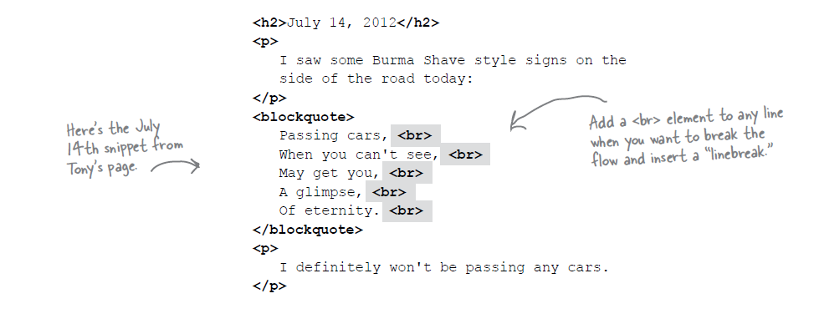
Line Breaks

Slide 10
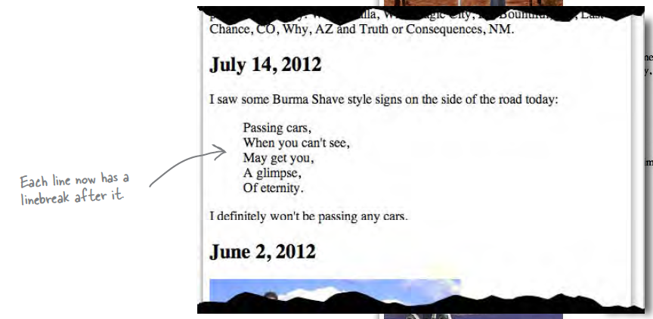
Line Breaks

Slide 11
Line Breaks
Break: <br> </br>
An Empty element: - sometimes shortened to:
<br></br>
or just
<br>
or
<br />

Slide 12
Block vs Inline Elements
Block elements are always displayed as if they have a line break before and after them
inline elements appear “in line” within the flow of the text in your page.
“Block elements stand on their own; inline elements go with the flow.”

Slide 13
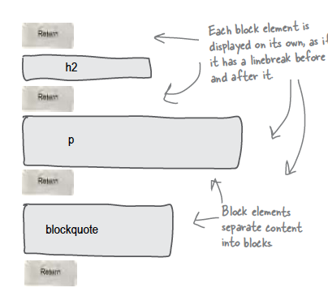
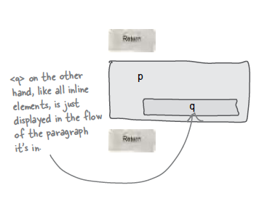
Examples
Block - h1, h2, p, blockquote
Inline - a, em, q

Slide 14
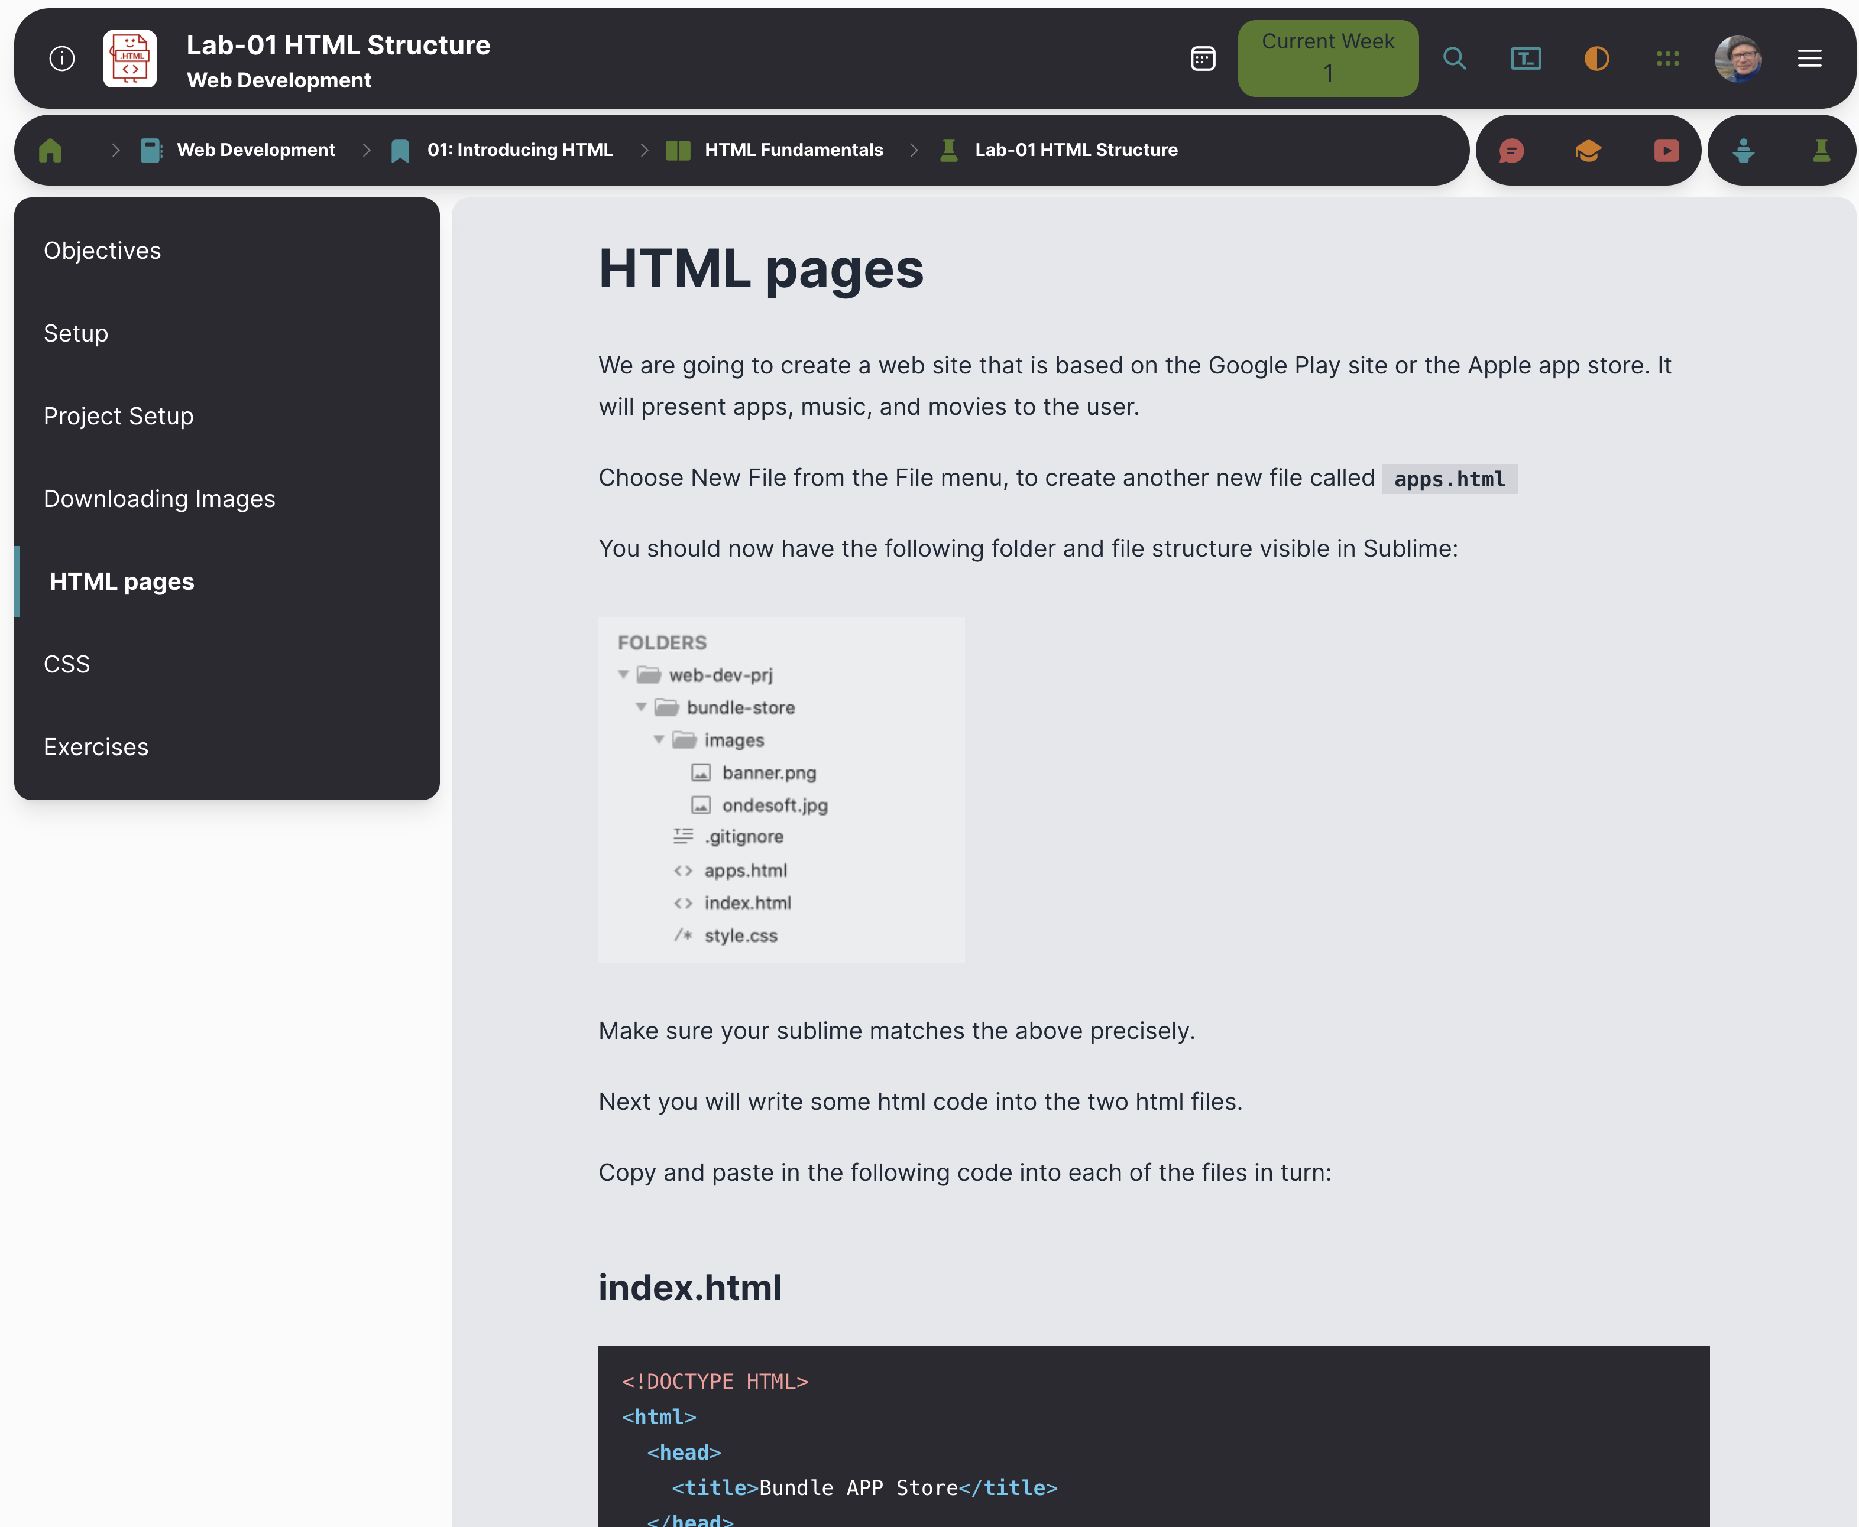
Labs
Steps
Instructions for each step

Slide 15
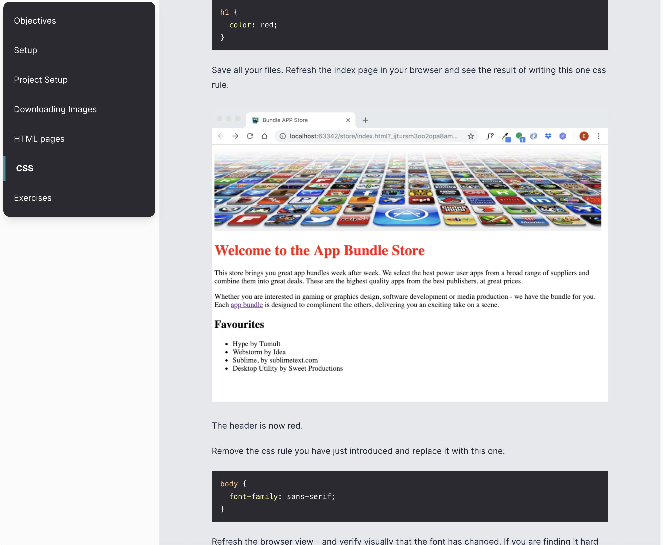
Typical Lab Step:
Screen shots to show outcome
Some html to type
More screen shots to show expected outcome
Reflect as you go along

Slide 16
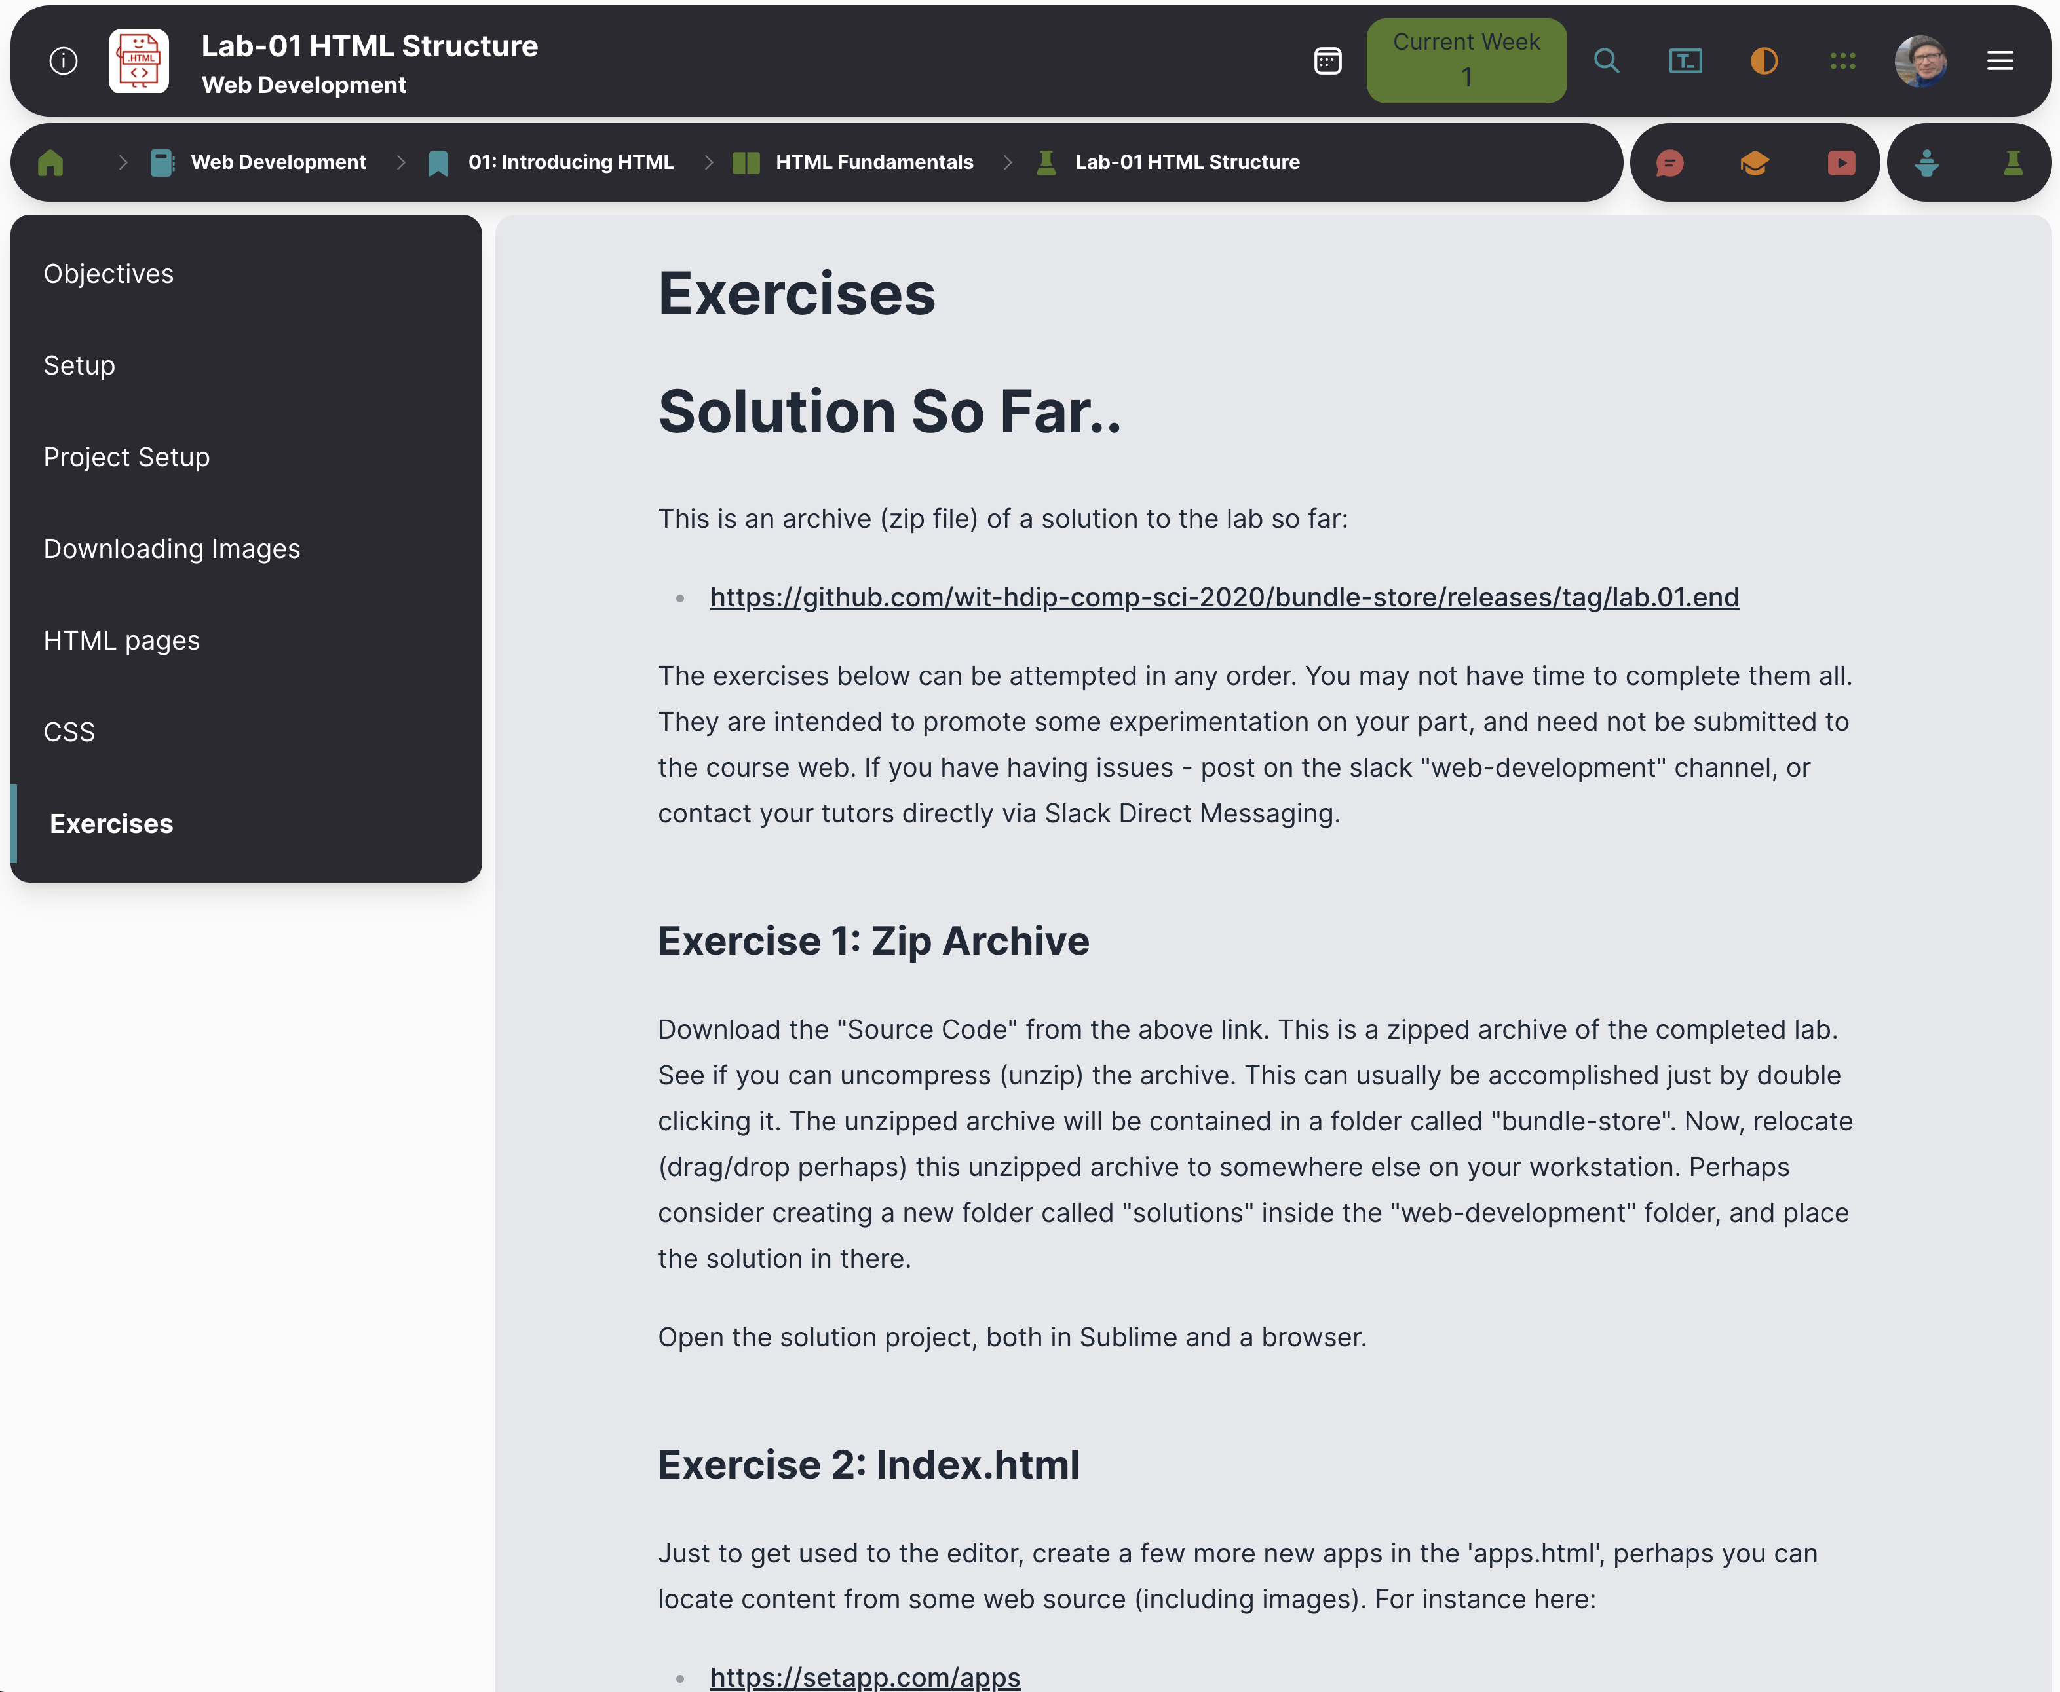
Exercises
To assist on reflection and independent learning.
Not essential you attempt all of them (yet)
Select a few that interest you or that you have time to work on

